Slide 1
Projections and Lab Study with Aquamembranes
Sept-2024

Slide 2
Outline
Conventional reverse osmosis (RO) vs semi-batch RO (SBRO)
Spiral wound RO membranes
Normal RO membrane vs Aquamembranes
Comparison of normal RO membranes vs Aquamembranes and RO vs SBRO based on projections
Experimental results on normal RO membranes vs Aquamembranes

Slide 3
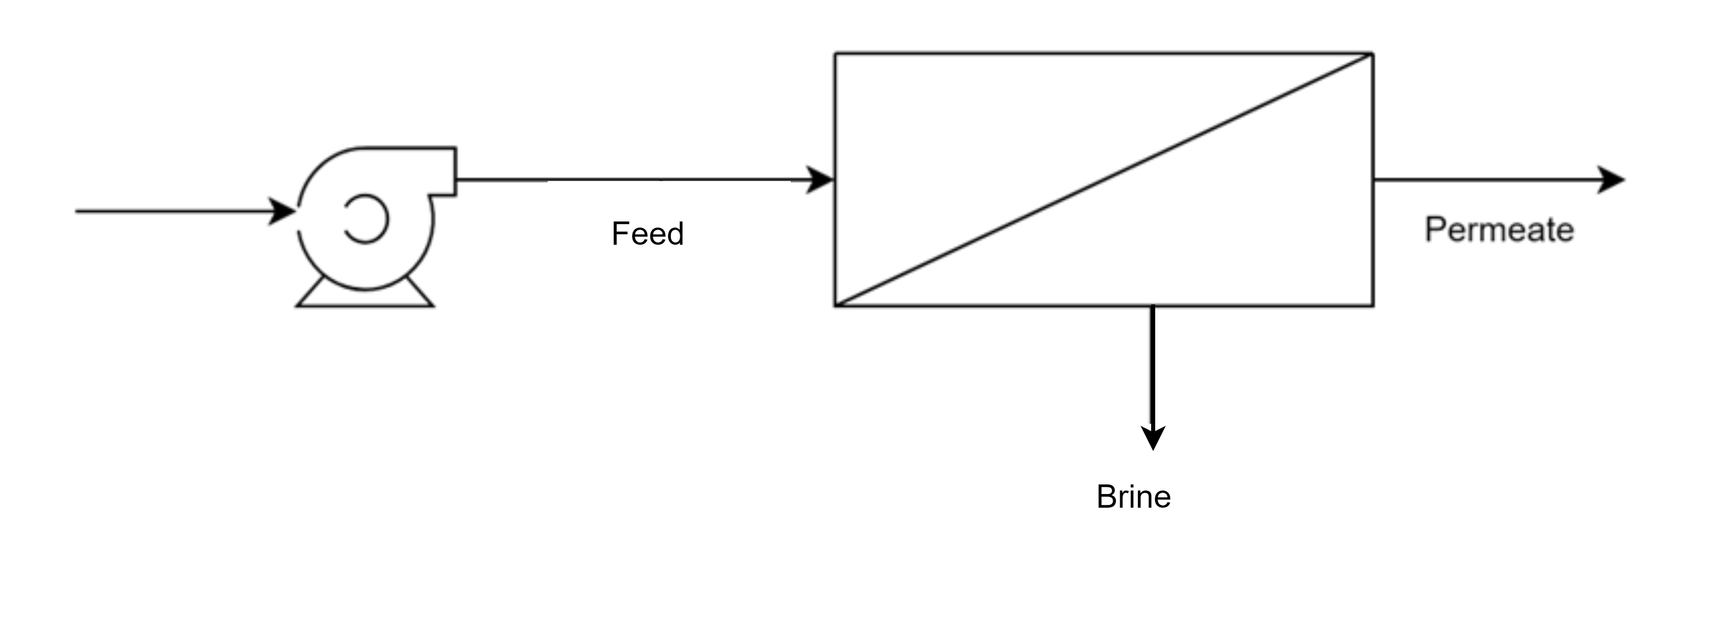
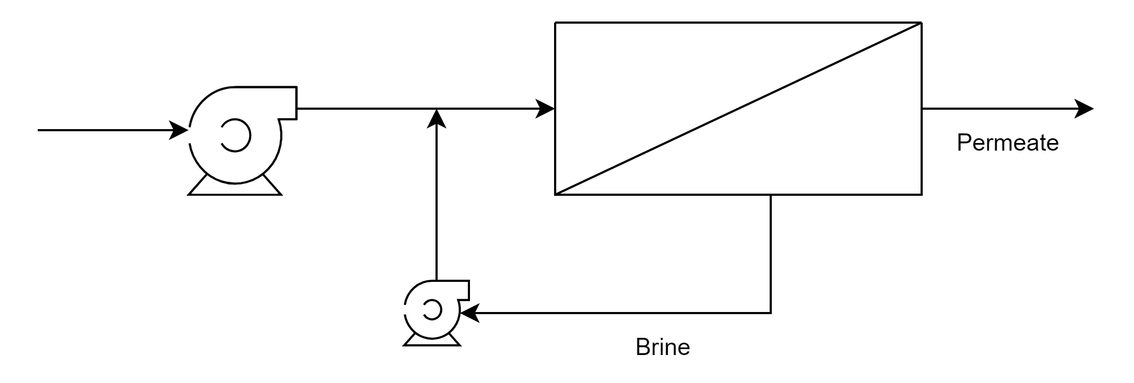
Reverse osmosis (RO) vs semi-batch RO (SBRO)
RO
Continuous process where water is forced through a semi permeable membrane
High pressure is required throughout the process due to operation in a steady state
Produces a significant amount of brine and recovery is limited with single stage operation
RO
Semi-batch RO
SBRO
The process operates in cycles and water is filtered through the membrane until a certain concentration, after which the system is flushed, and new cycle begins
More efficient use of energy due to the operation in batch cycles
Offers higher recovery rates and lower brine production

Slide 4
Conventional RO vs semi-batch RO
Parameter | Conventional RO | Semi-batch RO
Continuous operation | Yes | Partially, it involves a flushing cycle
Water flow | Continuous | Intermittent
System complexity | Lower | Moderate, with recirculation pump and additional control valve
Energy consumption | Constant (unless with fouling/scaling) | Could be reduced during the service cycle
Product water quality | Consistent | Vary within cycles
Reject production | Continuous reject production | Reject produced during flushing step
Footprint | Large with high recovery | Relatively smaller even with high recovery
Cleaning frequency | More frequent | Less frequent due to semi-batch flushing
Conventional RO
Feed
Product
Brine
Semi-batch RO
Product
Feed recirculation

Slide 5
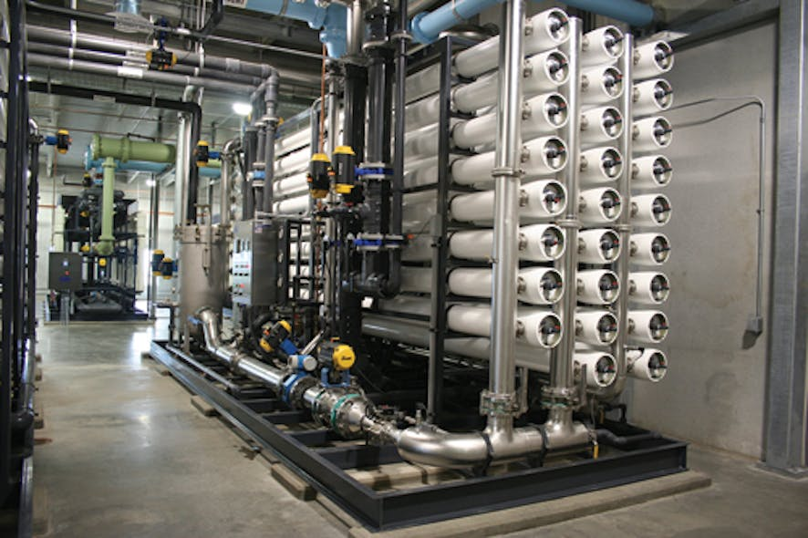
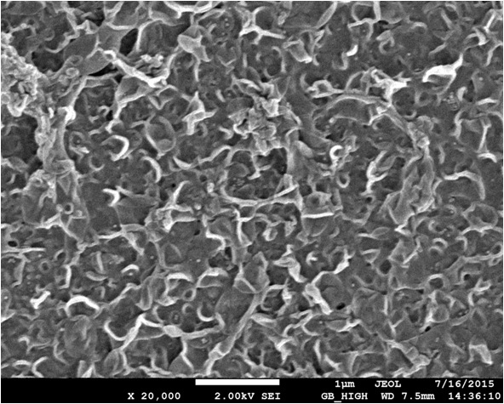
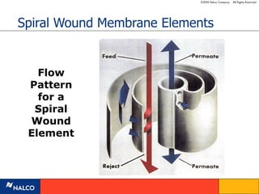
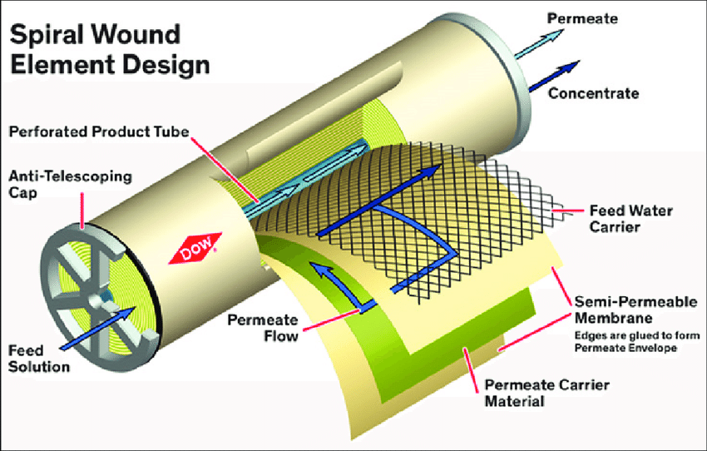
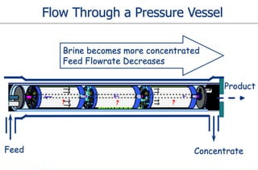
Spiral wound RO membranes are used in both RO and SBRO process
Polyamide membrane
Blackmore, Lars. (2016). Autonomous precision landing of space rockets. 46. 15-20.
https://www.waterworld.com/drinking-water/treatment/article/16190080/pressure-vessels-the-face-of-the-ro-industry

Slide 6
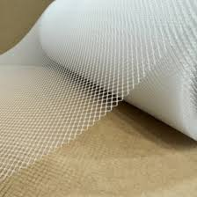
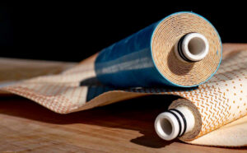
Normal RO membranes vs Aquamembranes
Normal RO Spacer
Aquamembranes with 3D printed spacer
Mesh type spacer e.g. Dupont CR100
3D printed spacer on membranes e.g. Aquamembranes
Reduces energy consumption by up to 30% due to lower pressure drop
Both membranes/spacers can be used in conventional RO and SBRO process
https://municipalwaterleader.com/craig-beckman-of-aqua-membranes-improving-membrane-filtration-with-3-d-printing/

Slide 7
LSR feed water quality
Parameter | Unit | LSR Feed (mg/L)
Ammonium as NH4 | mg/L | 5
Potassium | mg/L | 1
Sodium | mg/L | 325.7
Magnesium | mg/L | 8
Calcium | mg/L | 0.9
Carbonate | mg/L | 1.97
Bicarbonate | mg/L | 110.1
Nitrate | mg/L | 10
Fluoride | mg/L | 198
Chloride | mg/L | 50
Sulfate | mg/L | 58
Phosphate | mg/L | 1
Silica as SiO2 | mg/L | 80
Carbon dioxide CO2 | mg/L | 0.81
Total dissolved solid (TDS) | mg/L | 850.7
Conductivity | µS/cm | 1498
pH | NA | 8.2
7

Slide 8
SBRO vs RO projections

Slide 9
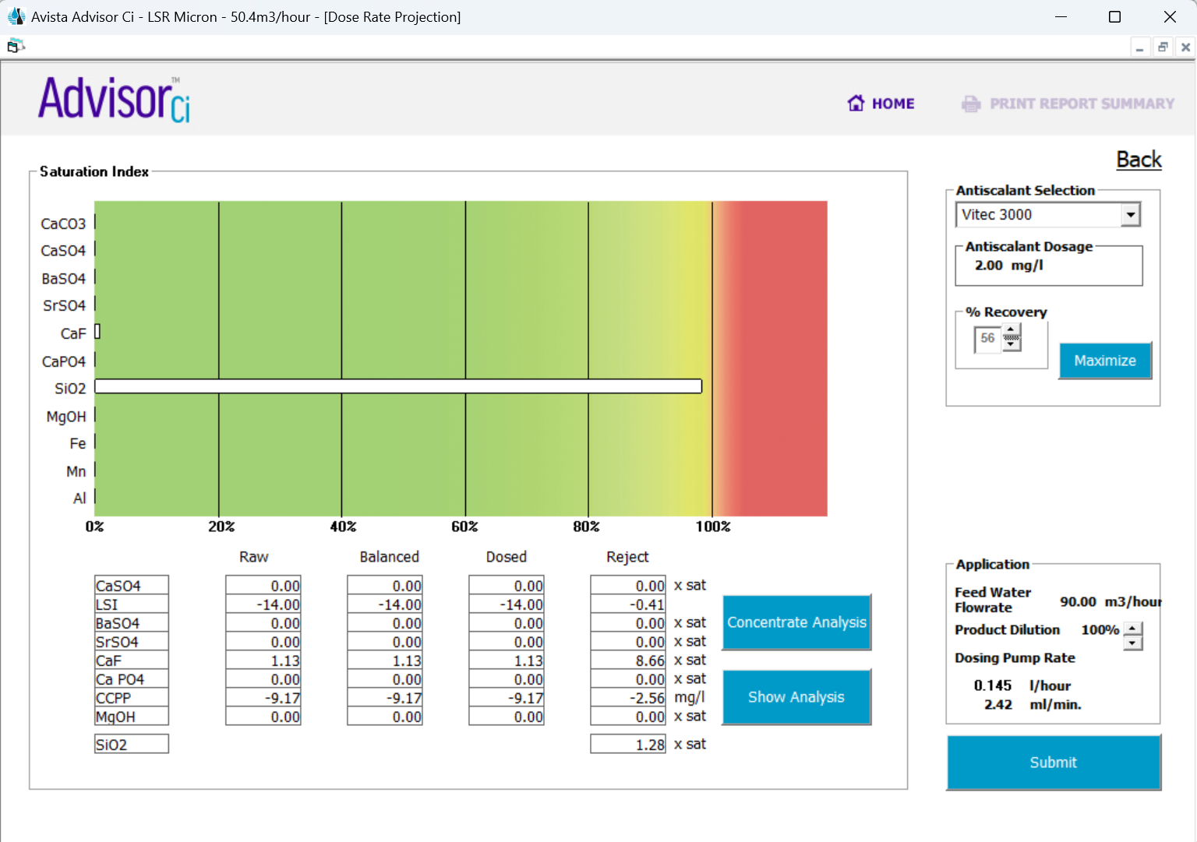
RO projection on LSR water quality at maximum recovery
Projection shows 56% as the max recovery for conventional RO
SiO₂ will be supersaturated when the recovery >56%

Slide 10
Comparison of RO vs SBRO – same feed flow = 90 m3/h, different flux
 | RO – 56 % recovery Product flow = 50.4 m3/hr |  |  |  |  | RO – 93% recovery Product flow = 83.7 m3/h |  |  |  |  | SBRO – 93% recovery Product flow = 83.7 m3/h
Membrane | Flux (LMH) | RO feed pressure (bar) | RO Specific Energy (kWh/m3) | Permeate TDS (mg/L) | CIP frequency | Flux (LMH) | RO feed pressure (bar) | RO Specific Energy (kWh/m3) | Permeate TDS (mg/L) | CIP frequency | Flux (LMH) | SBRO max feed pressure (bar) | SBRO Specific Energy (kWh/m3) | Permeate TDS (mg/L) | CIP frequency
Dupont CR100 (Wave) | 13.3 | 4.7 | 0.29 | 18.67 | 4 times per year | 22.6 | 10.1 | 0.38 | 40.70 | 365 times per year | 22.6 | 10.1 | 0.27 | 80.37 | 3 times per year
AQ-AM-BW505-ECO1.0 | 10.6 | 3.91 | 0.24 | 18.61 | 4 times per year | 17.9 | 8.62 | 0.32 | 51.15 | 365 times per year | 17.9 | 8.62 | 0.21 | 134.51 | 3 times per year
‡RO and SBRO projection is carried out with 17 PV x 6 Element
Key findings:
The RO production (product flow) at 56% recovery is lower than that at 93.1 % recovery
Energy consumption at 93.1% recovery = RO-CR100 > RO-AQ > SBRO-CR100 > SBRO-AQ
The energy consumption is ~30% lower for SBRO compared to RO
Aquamembranes can save ~22% energy in the SBRO process compared to the Dupont membrane → AQ is operating at lower flux (same feed flowrate) due to the larger membrane area → this leads to higher permeate TDS for AQ
Impractical to operate RO at 93% recovery due to the infinite amount of CIP (due to scaling of CaF₂ and SiO2) needed per year as compared to SBRO
SBRO shows lesser CIP frequency due to the semi-batch flushing after each service cycle
10

Slide 11
Comparison of RO vs SBRO – Same flux, higher feed flow
 | RO – 56% recovery Flux = 13.3 LMH |  |  |  |  |  | RO – 93% recovery Flux = 22.6 LMH |  |  |  |  |  | SBRO – 93% recovery Flux = 22.6 LMH
Membrane | Feed flow (m3/hr) | Product flow (m3/h) | RO feed pressure (bar) | RO Specific Energy (kWh/m3) | Permeate TDS (mg/L) | CIP frequency | Feed flow (m3/h) | Product flow (m3/h) | RO feed pressure (bar) | RO Specific Energy (kWh/m3) | Permeate TDS (mg/L) | CIP frequency | Feed flow (m3/h) | Product flow (m3/h) | SBRO max feed pressure (bar) | SBRO Specific Energy (kWh/m3) | Permeate TDS (mg/L) | CIP frequency
Dupont CR100 (Wave) | 90 | 50.4 | 4.7 | 0.29 | 18.67 | 4 times per year | 90 | 83.7 | 10.10 | 0.38 | 40.70 | 365 times per year | 90 | 83.7 | 10.1 | 0.27 | 80.37 | 3 times per year
AQ-AM-BW505-ECO1.0 | 114 | 63.84 | 4.66 | 0.29 | 14.90 | 4 times per year | 114 | 106.1 | 9.90 | 0.37 | 43.24 | 365 times per year | 114 | 106.1 | 9.90 | 0.25 | 111.63 | 3 times per year
Key findings:
The RO energy consumption at 56% recovery is the same at the same flux for CR100 and AQ
Energy consumption at 93% recovery = RO-CR100 ≈ RO-AQ > SBRO-CR100 ≈ SBRO-AQ
Operation at higher flux for AQ improves the permeate quality
The energy consumption is similar for both CR100 and AQ due to the operation at high flux for AQ
‡RO and SBRO projection is carried out with 17 PV x 6 Element
11

Slide 12
ROI SBRO experimental study

Slide 13
Objective
Pilot study was conducted using the ROI semi-batch reverse osmosis (SBRO) setup in lab with synthetic wastewater to investigate the following parameters
Effluent quality
Operating feed pressure
Effect of recirculation flowrate
3x Aquamembranes AM-BW4040-ECO1.0 and Dupont CR100-4040 were used to evaluate the performance

Slide 14
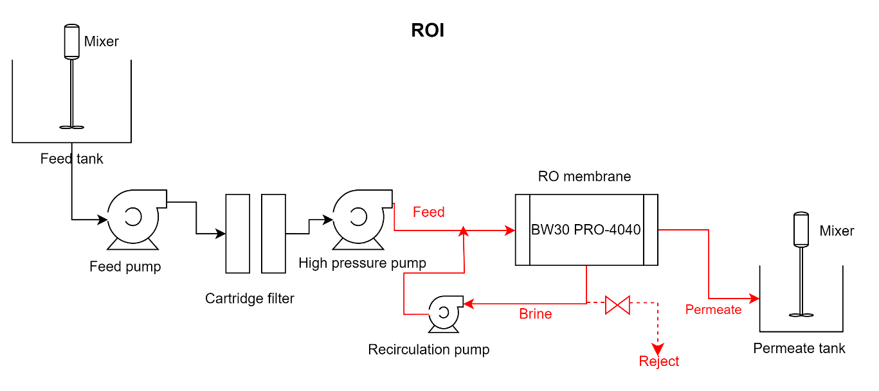
Schematic diagram of ROI SBRO
Feed flowrate = 0.21 m3/hr
Permeate flowrate = 0.19 m3/hr
Temperature = 25 °C
Recirculation ~0.16 m3/hr & Higher recirculation flow ~0.25 m3/hr
CR-100-4040 or Aquamembranes

Slide 15
Water analysis - Synthetic water testing for CR100-4040, Flux = 26.3 LMH
Sample | Feed | Reject | Permeate – normal recirculation flow | Permeate – higher recirculation flow
pH | 8.36 | 8.27 | 8.61 | 8.66
Conductivity (µS/cm) | 2300 | 5900 | 50.9 | 52.1
Bicarbonate alkalinity | 148 | 325 | 14.55 | 14.75
Fluoride (mg/L) | 323.5 | 886 | 3.31 | 2.96
Chloride (mg/L) | 97.9 | 290 | 2.56 | 2.495
Sulfate (mg/L) | 86.1 | 232 | 0.16 | 0.3
Nitrate (mg/L) | 4.38 | 10.6 | 0.34 | 0.33
Aluminium (mg/L) | 0.165 | 0.18 | <0.1 | <0.1
Boron (mg/L) | 10.6 | 25.7 | 5.37 | 5.87
†Calcium (mg/L) | 9.21 | 9.7 | <0.1 | <0.1
Magnesium (mg/L) | 0.941 | 1.33 | <0.1 | <0.1
Iron as Fe (mg/L) | <0.1 | <0.1 | <0.1 | <0.1
Potassium (mg/L) | 13.75 | 15.8 | 0.38 | 0.23
Total Silica (mg/L) | 11.35 | 29.7 | <0.2 | <0.2
Sodium (mg/L) | 456.5 | 1345.5 | 8.95 | 11.3
TDS (mg/L) | 1100 | 3049.5 | 54.5 | 45.5
Permeate fluoride < 15 mg/L
Rejection = 95.0 - 95.9%
15

Slide 16
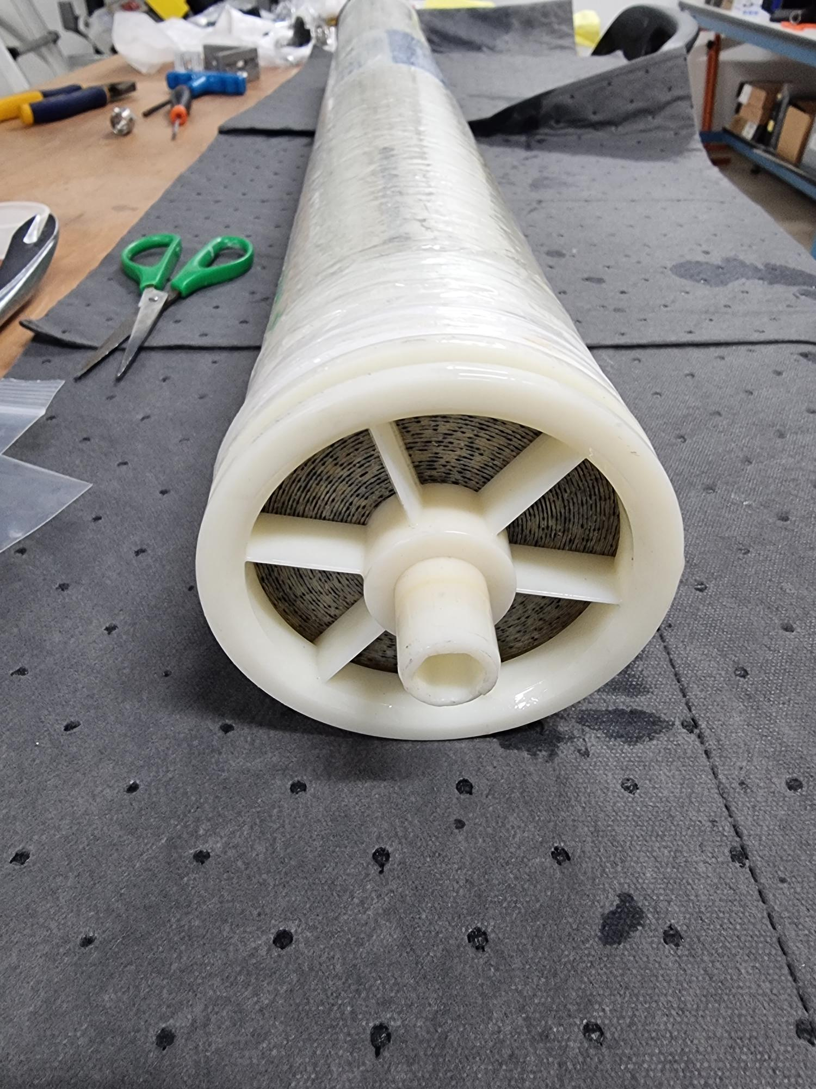
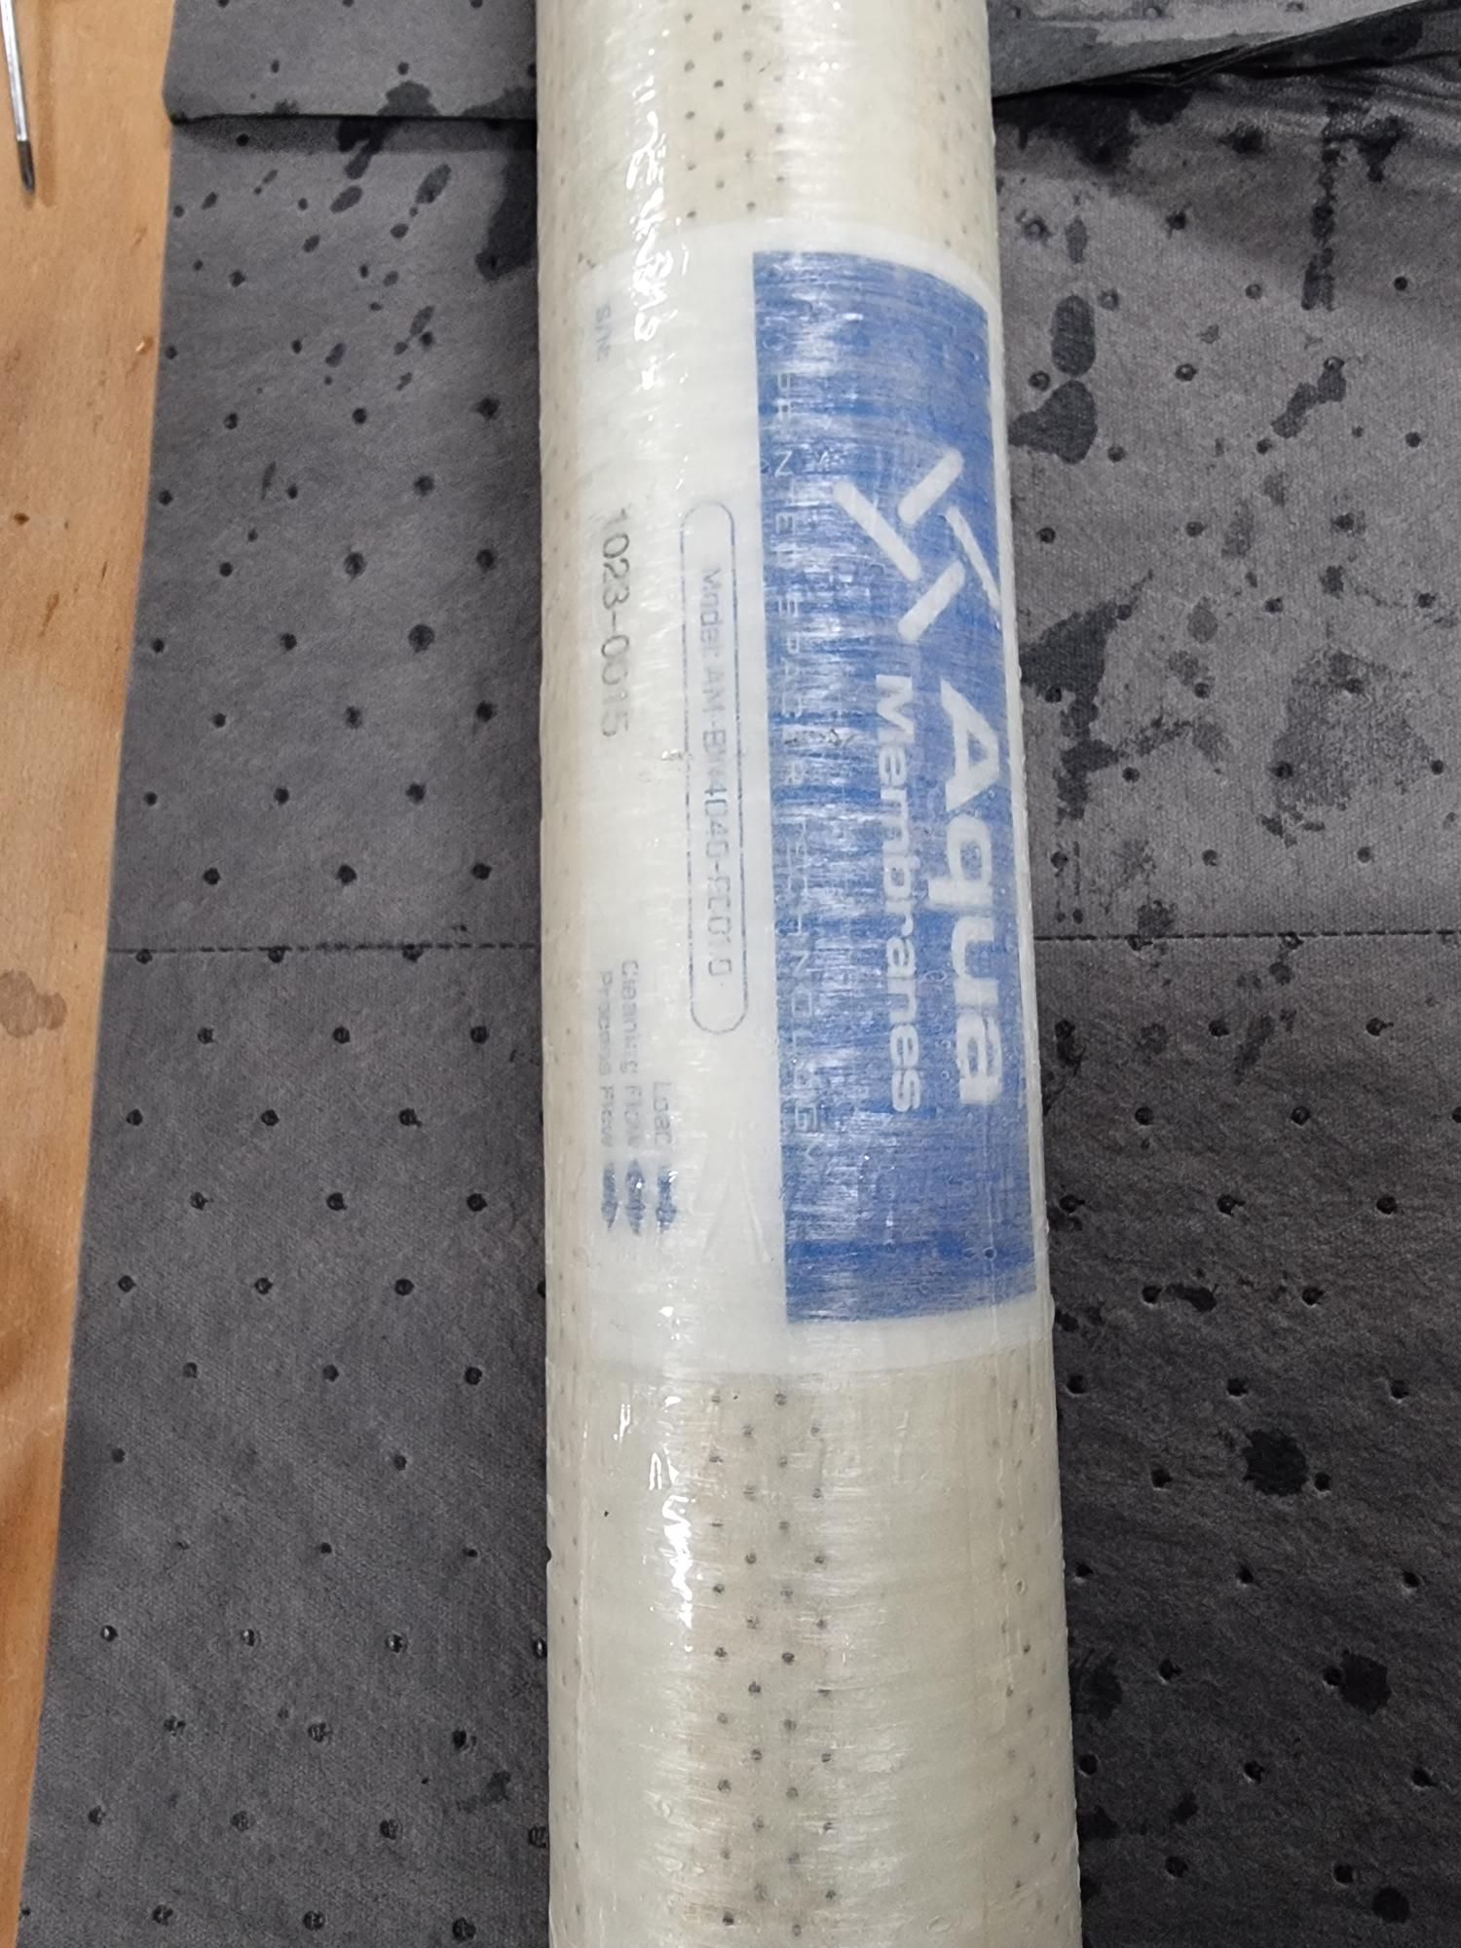
Rejection data at Aquamembranes AM-BW4040-ECO1.0
Element | Rejection (%) | Permeate Flow (GPD)
1023-0015 | 99.32% | 3311
1023-0034 | 99.53% | 3408
1023-0040 | 99.48% | 3247
Data obtained from Aquamembranes
Elements tested at 15.5 bar (225 psi), 500 ppm and 12 – 13% recovery at Aquamembranes

Slide 17
Partial Analysis for Aquamembranes 2 – 1023-0034, Flux = 21.6 LMH
Sample | Feed | Reject | Permeate - normal recirculation flow | Permeate – higher recirculation flow
pH | 7.54 | 7.83 | 7.06 | 7.35
Conductivity (µS/cm) | 2185 | 6310 | 128.5 | 117.5
Bicarbonate alkalinity | 128.5 | 352.5 | 13.25 | 15.05
Fluoride (mg/L) | 308 | 874 | 15.75 | 14
Chloride (mg/L) | 96.95 | 343 | 4.30 | 3.95
Sulfate (mg/L) | 79.1 | 259 | 0.24 | 0.21
Nitrate (mg/L) | 2.9 | 7.41 | 0.62 | 0.56
Aluminium (mg/L) | 0.105 | <0.1 | <0.1 | <0.1
Boron (mg/L) | 9.46 | 12.3 | 9.58 | 9.27
†Calcium (mg/L) | 10.9 | 4.39 | <0.1 | <0.1
Magnesium (mg/L) | 0.675 | 2.25 | <0.1 | <0.1
Iron as Fe (mg/L) | <0.1 | <0.1 | <0.1 | <0.1
Potassium (mg/L) | 9.44 | 13.6 | 1.03 | 0.568
Total Silica (mg/L) | 6.78 | 22.2 | 2.20 | 2.39
Sodium (mg/L) | 435.5 | 1393 | 25.8 | 25.5
TDS (mg/L) | 1052 | 3072 | 65 | 87
Permeate fluoride > KPI of 15 mg/L for operation with normal recirculation flow
Rejection = 91.7 - 93.8%
17

Slide 18
18

Slide 19
Comparison of CR100 and AM at the same flux
At the same permeate flux, the max operating pressure for both the membrane is around ~15 bar
Due to the larger membrane area of Aquamembrane, the operating flux is lower at the same permeate flowrate → lower operating pressure compared to CR100-4040

Slide 20
Energy consumption and permeate quality
Membrane | Permeate fluoride | Fluoride rejection (%) | Permeate fluoride – high recirc flow | Fluoride rejection (%) – high recirc flow
CR100 | 3.31 | 98.98 | 2.96 | 99.09
AM1-1023-0015 | 33.9 | 88.99 | 17.5 | 94.32
AM2-1023-0034 | 15.75 | 94.89 | 14.0 | 95.45
AM4-1023-0040 | 13.9 | 94.91 | 13.1 | 95.20
AM4-1023-0040 higher flux | 11.1 | 95.93 | - | -

Slide 21
Summary
Aquamembranes generally shows a lower energy consumption than CR100
However, the permeate fluoride of Aquamembranes does not meet the KPI of <15 mg/L from most of the cases
The 4040 membrane is hand-rolled in Aquamembranes and does not truly representing the 8040 membrane elements
The performance of AQ 8040 membrane elements would need to be verified with on-site testing

